Slide 1



Slide 2

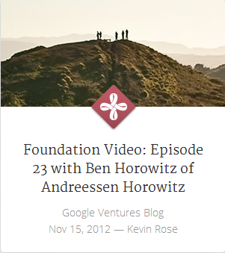



Antera ventures
about
companies
people
jobs
blog
contact

Slide 3
Antera ventures
about
companies
people
jobs
blog
contact

Slide 4
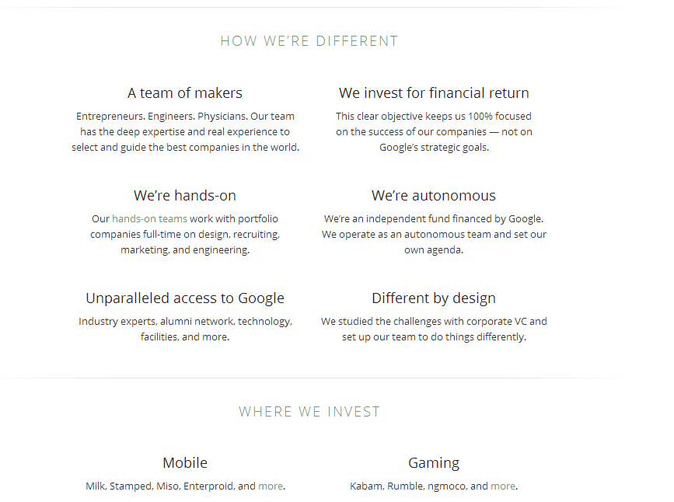
Antera ventures
about
companies
people
jobs
blog
contact

Slide 5











Antera ventures
about
companies
people
jobs
blog
contact

Slide 6


Antera ventures
about
companies
people
jobs
blog
contact
INVESTMENT TEAM
REGIONAL MANAGERS

